Slide 1
Introduction to Source Coding
Dr. Arup Kumar Pal
Department of Computer Science & Engineering
Indian Institute of Technology (ISM)
Dhanbad, Jharkhand-826004
E-mail: arupkrpal@gmail.com

Slide 2
Outline
Purpose of Compression
Fundamentals of Data Compression
Some Source Coding Techniques
References

Slide 3
Purpose of Compression
Gray Scale Image: 720×480 = 337.5KB
Color Image: 720×480 = 0.99 MB
90 minutes Color Video: 720×480×30frames/sec=157 GB
Internet Speed: 56kbps
Approx. download time: 49 seconds, 148 seconds and 278 days respectively.
Outcomes of Compression:
Reduce Storage Space
Reduce Transmission Time
Reduce Data access Time

Slide 4
Data Compression
Compression consists in reducing the physical size of information blocks.
Compression is achieved by removing data redundancy while preserving information content.
To adopt suitable coding and approaches for achieving the more compact representation of the data.

Slide 5
Example-1
Consider the following sequence BDBCACDBCDBDBDACDA
Total No of Characters: 18
Representation of Code:
00 for A, 01 for B, 10 for C and 11 for D
Here the sequence is generated by a process that follows the following rules: (i) A is followed by B or C; (ii) B is followed by C or D; (iii) C is followed by A or D; (iv) D is followed by A or B
B | D | B | C | A | C | D | B | C | D | B | D | B | D | A | C | D | A
01 | 1 | 1 | 0 | 0 | 1 | 1 | 1 | 0 | 1 | 1 | 1 | 1 | 1 | 0 | 1 | 1 | 0

Slide 6
Example-2
Consider the following sequence
9 | 11 | 11 | 11 | 14 | 13 | 15 | 17 | 16 | 17 | 20 | 21
0 | 1 | 0 | -1 | 1 | -1 | 0 | 1 | -1 | -1 | 1 | 1
Representation of Code:
00 for -1, 01 for 0 and 10 for 1

Slide 7
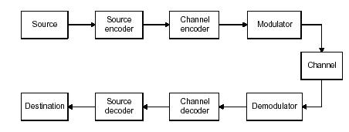
Communication System
General model of a communication system

Slide 8
Source Coding
The goal of source coding for digital systems is two fold:
Uniquely map any arbitrary source message to a binary code and back again.
Efficiently map a source message to the most compact binary code and back again.
Techniques are
Fixed-length code
Variable-length code (Goal: Minimizing the average code word length)

Slide 9
Channel Coding
Channel coding is considered for reliable communication between transmitter and receiver.
Two policies to deal with channel coding are:
Forward Error Correction (FEC)
Automatic Repeat Request (ARQ)

Slide 10
Uniquely Decodable Codes
Variable length code assigns a bits of string (codeword) of variable length to every message value
e.g. a = 1, b = 01, c = 101, d = 011
What if you get the sequence of bits 1011 ?
Is it aba, ca, or, ad?
Uniquely decodable code is a variable length code in which bit strings can always be uniquely decomposed into its codewords.

Slide 11
Prefix Codes
Prefix code is a variable length code in which no codeword is a prefix of another word
It is possible to decode each message in an encoded string without reference to succeeding code symbols.

Slide 12
Example
Source | Code 1 | Code 2
a₁ | 0 | 0
a₂ | 10 | 01
a₃ | 110 | 011
a₄ | 1110 | 0111
Code1 is Prefix code.

Slide 13
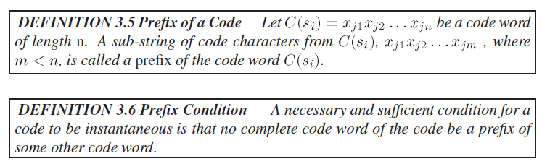

Slide 14
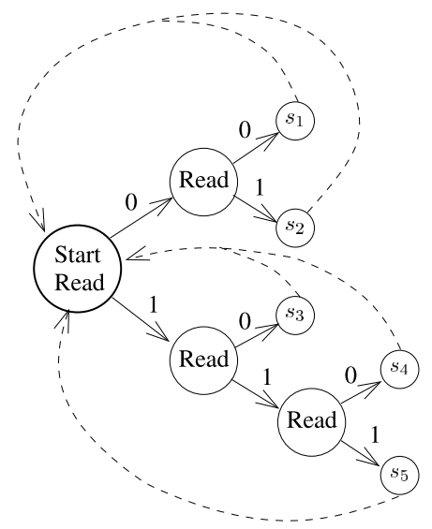
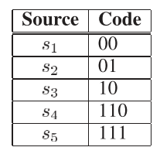
Decoding Prefix Codes

Slide 15
The Kraft Inequality
If the individual code word lengths are specified there is no guarantee that an instantaneous code can be designed with those lengths.
The Kraft Inequality theorem provides a limitation on the code word lengths for the design of instantaneous codes.
It only indicates whether an instantaneous code can be designed from the given code word lengths.

Slide 16
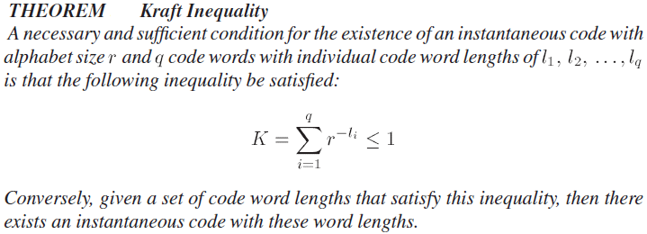

Slide 17
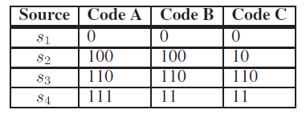
Example

Slide 18
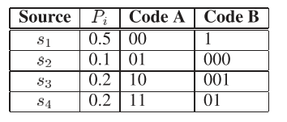
Compact Code
Definition: The code will be compact code if its average length is less than or equal to the average length of all other uniquely decodable codes for the same source and code alphabet.

Slide 19
Entropy
Definition: Shannon’s measure of information is the number of bits to represent the amount of uncertainty (randomness) in a data source, and is defined as entropy.
Theorem: Shannon’s Noiseless Coding Theorem Let L be the average length of a compact code for the source S, then

Slide 20
Efficiency of Code
The efﬁciency of the code is given by
Conclusion: Code B can not be improved more than 2%

Slide 21
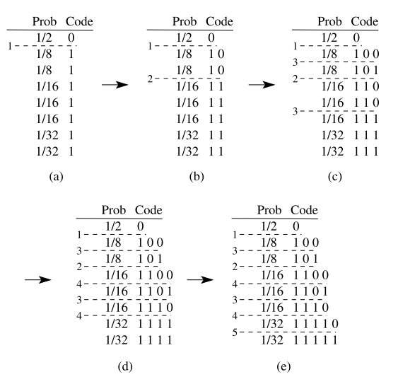
Shannon Fano Codes
It does not give optimal variable length code

Slide 22
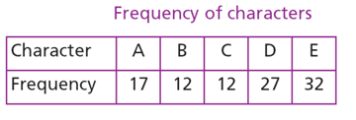
Huffman Codes
Key idea: Assign fewer bits to symbols that occur more frequently and more bits to symbols appear less often.
Huffman codes are compact codes.

Slide 23
Huffman Code Design
Requirement: The source probability distribution.
(Not Available in many cases)
Procedure:
Step 1: Sort the probability of all source symbols in descending order.
Step 2: Merge the last two into new symbol, add their probabilties
Step 3: Repeat Step 1 and Step 2 until one symbol is left
Step4: Code assignment, traverse the tree from the root to each leaf node

Slide 24
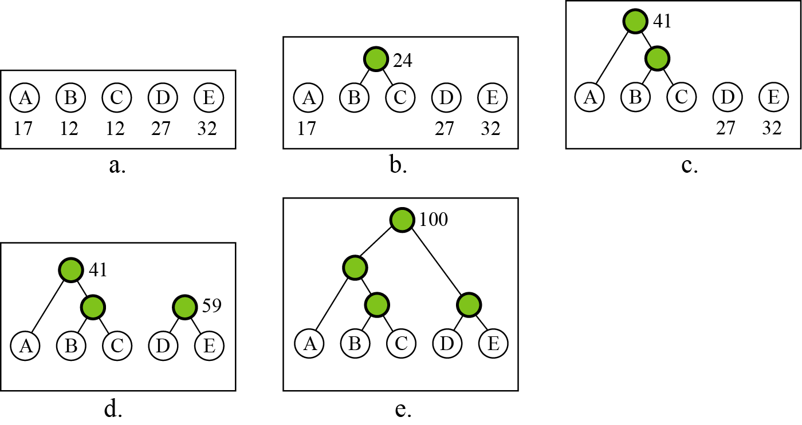
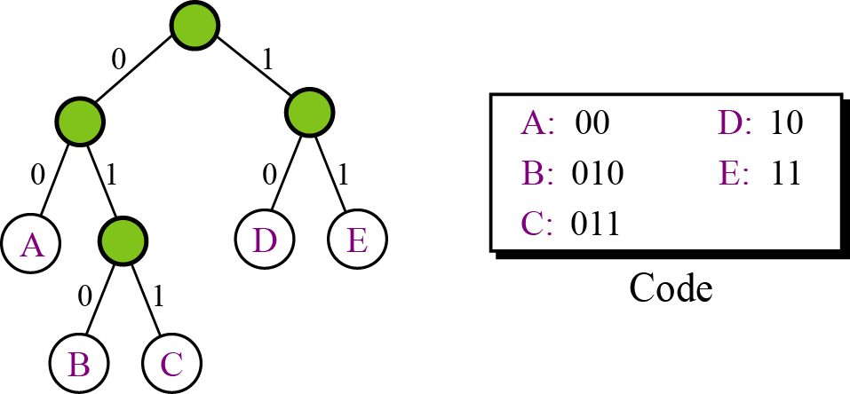
Binary Huffman Coding

Slide 25
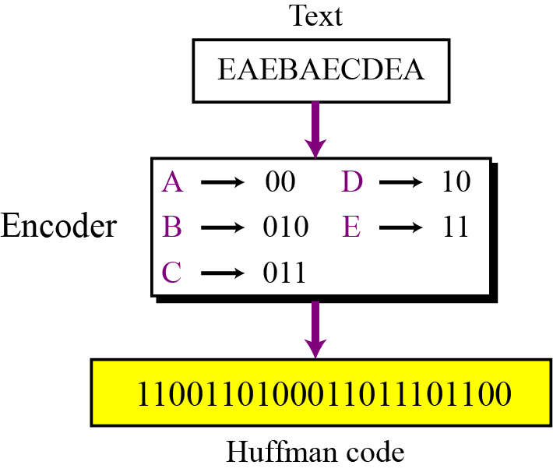
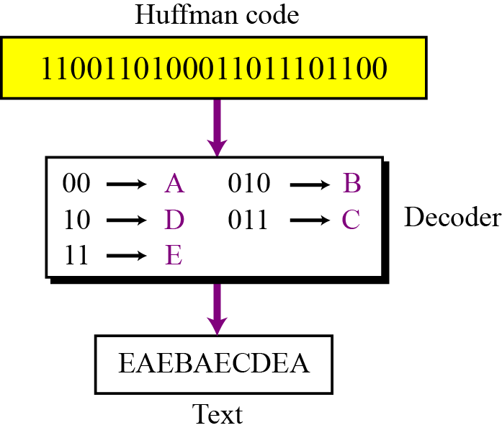
Binary Huffman Coding (Cont’d)
Encoding Total No of bits:50
Total No of bits:22
Decoding

Slide 26
Minimum Variance Huffman Codes
Same probabilities of source may give a number of Huffman trees.
Approach: Put the combined symbol as high as possible in the sorted list
Average length variance,

Slide 27
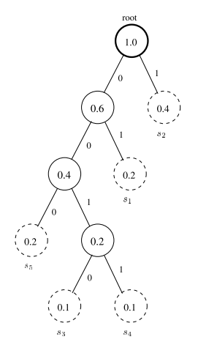
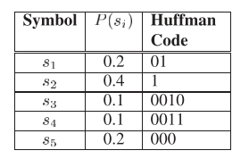
Minimum Variance Huffman Codes

Slide 28
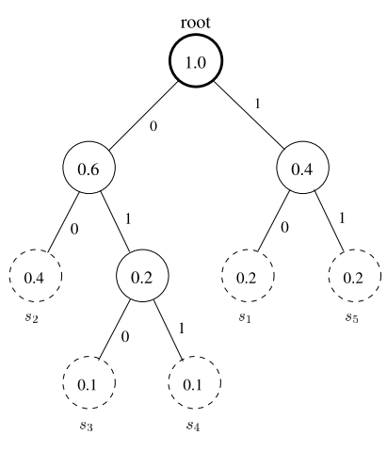
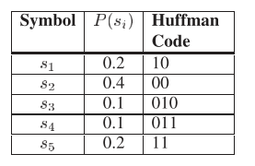
Minimum Variance Huffman Codes

Slide 29
Canonical Huffman Codes
Canonical Huffman Code is well structured.
Rules:
Assign 0 to left branch and 1 to right branch
Build the tree from left to right in increasing order of depth
Each leaf is placed at the first available position

Slide 30
Canonical Huffman Codes
Symbol (i) | Probability | Huffman Code 1 | Huffman Code 2 | Canonical Code
A (1) | 0.1 | 100 | 011 | 001
B (2) | 0.15 | 001 | 110 | 010
C (3) | 0.05 | 0000 | 1111 | 0000
D (4) | 0.09 | 0001 | 1110 | 0001
E (5) | 0.14 | 101 | 010 | 011
F (6) | 0.27 | 01 | 10 | 10
G (7) | 0.2 | 11 | 00 | 11

Slide 31
Performance of Huffman Codes

Slide 32
Arithmetic Coding
Huffman – needs to transmit Huffman tables with compressed data
Arithmetic – needs to transmit length of encoded string with compressed data

Slide 33
Arithmetic Coding: Encoding Example
Coding the message sequence: bac
The final interval is [.27,.3)
1.0
0.7
0.3
c = .3
c = .3
c = .3
0.7
0.55
0.27
b = .5
b = .5
b = .5
0.2
0.3
0.21
a = .2
a = .2
a = .2
0.0
0.2
0.2

Slide 34
Arithmetic Coding: Decoding Example
Decoding the number 0.49, knowing the message is of length 3:
The message is bbc.
1.0
0.7
0.55
c = .3
c = .3
c = .3
0.49
0.7
0.55
0.475
0.49
0.49
b = .5
b = .5
b = .5
0.2
0.3
0.35
a = .2
a = .2
a = .2
0.0
0.2
0.3

